Slide 1


VIDEO GAME SALES WITH RATINGS
By: Matthew Belizaire & Christopher Fredrick

Slide 2


01
Introduction
Brief History of Video Games

Slide 3




Video Game Facts
Gained Mainstream Popularity in the 70s and 80s
As of 2022, the video game industry is a multi-billion dollar industry
Has many genres including action, adventure, sports, strategy, simulation games, etc.
Some of the most successful video game franchises include Super Mario, Pokémon, Call of Duty, and The Legend of Zelda
The industry is constantly evolving and innovating, with new technologies and platforms allowing for more immersive and engaging experiences for players

Slide 4



The Data
Kaggle
Metacritic & VGChartz
Dataset: Video Game Sales with Ratings
Metacritic: Aggregates reviews from verified critics and reports the average score game titles’ score
VGChartz: Video game sales tracking website

Slide 5
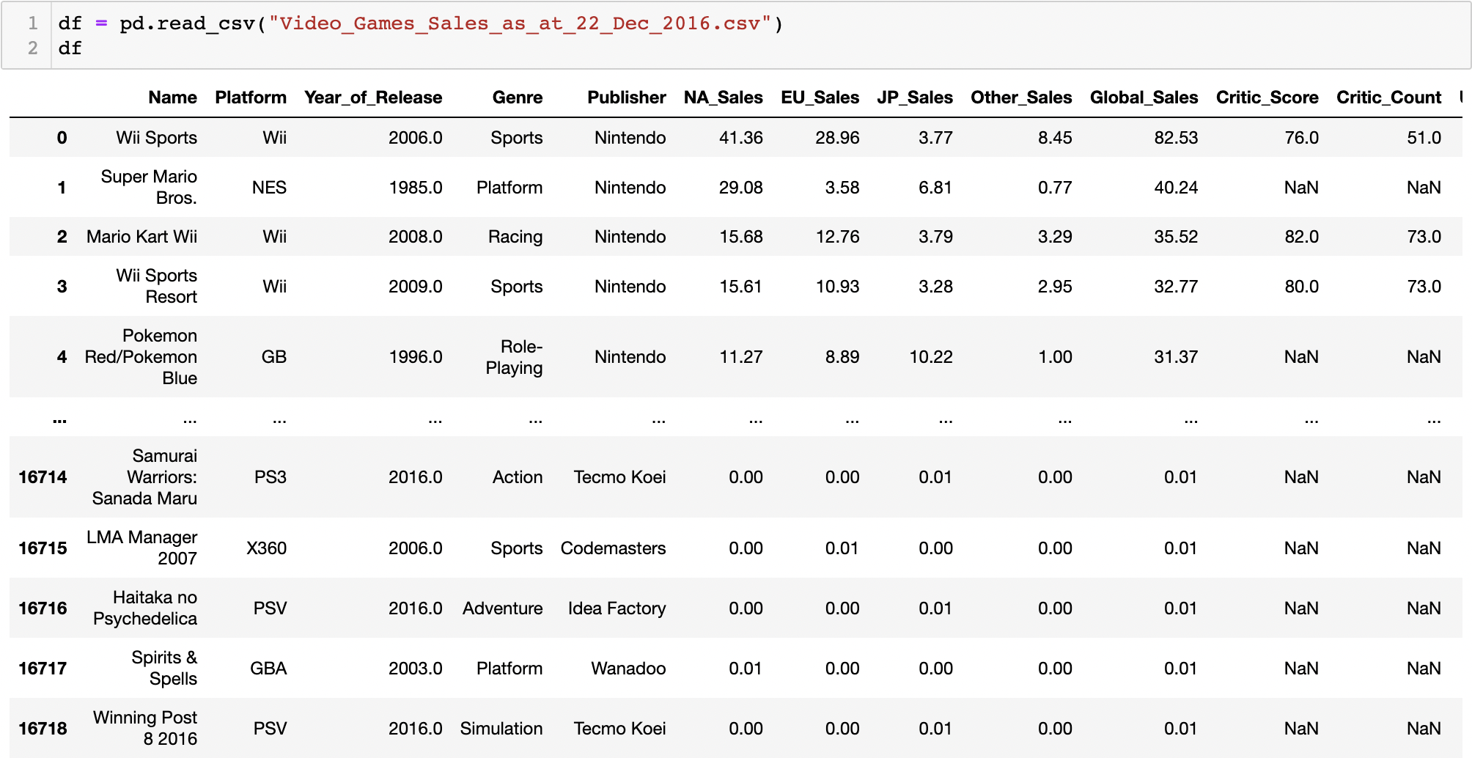
The Data
Dataset contains video game titles with over 100,000 sales
In total there are 16 variables and 16,719 rows, with 11,563 of the titles being unique
These variables include “Name,” “Platform,” “Year_of_Release,” “Global_Sales”, “Critic_Score,” “User_Score,” etc
There are duplicate titles because some games were released on multiple platforms, and the sales were calculated separately
This is what the Data looks like:

Slide 6

02
Exploratory Data Analysis
Better Understanding the Data

Slide 7
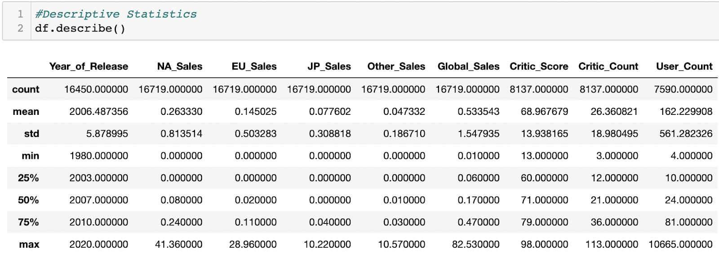
EDA
These summary statistics are used to provide a general overview of the data and to identify patterns and trends within the data. It aids in understanding this diverse and in some places complex dataset to make inferences based on the results.
NA_Sales has the highest mean. Can be an early indicator of video games being most popular within North America in comparison to Europe or Japan
We can expect the critic score to be composed of an average of about 26 critics, as shown by the mean of Critic_Count.
Other inferences can be made about the data from descriptive stats; but it is important to not be conclusive about anything we see here.

Slide 8
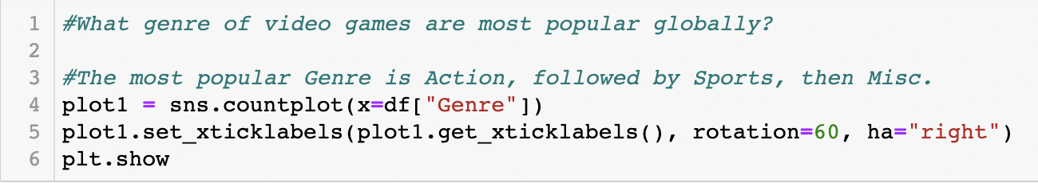
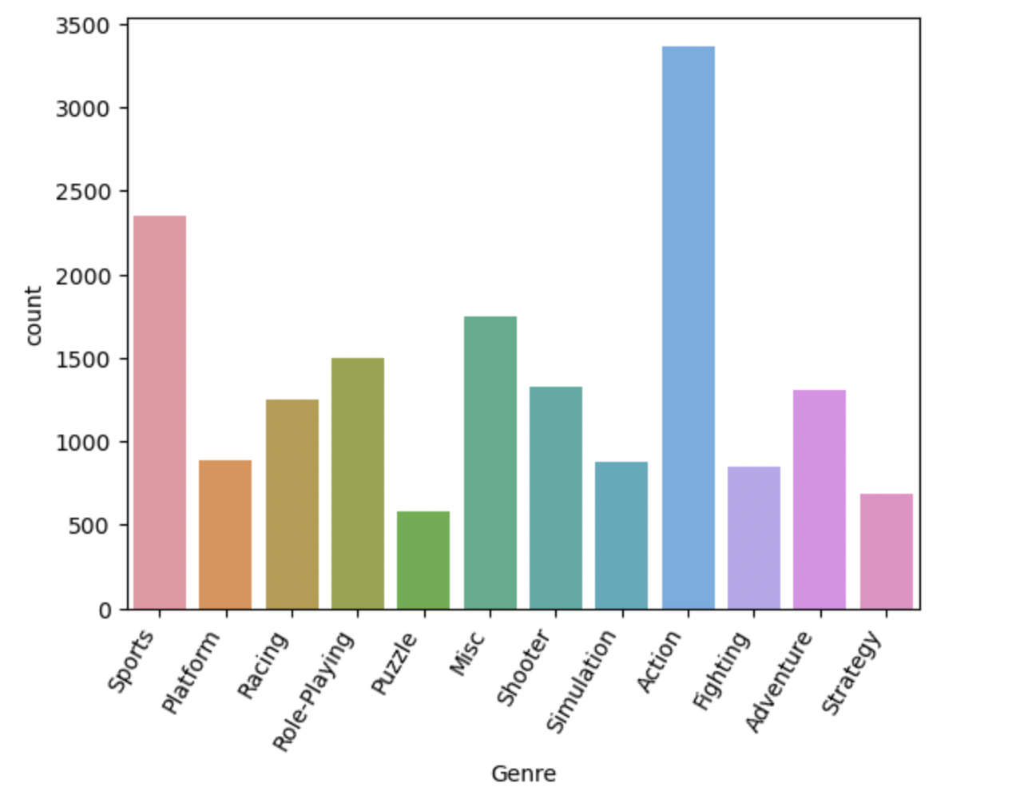
EDA (Cont.)
It’s shown that Action games are the most common games, followed by Sports, then Misc. This does not mean that they are the highest or best rated games, but simply that they possess the highest frequency

Slide 9
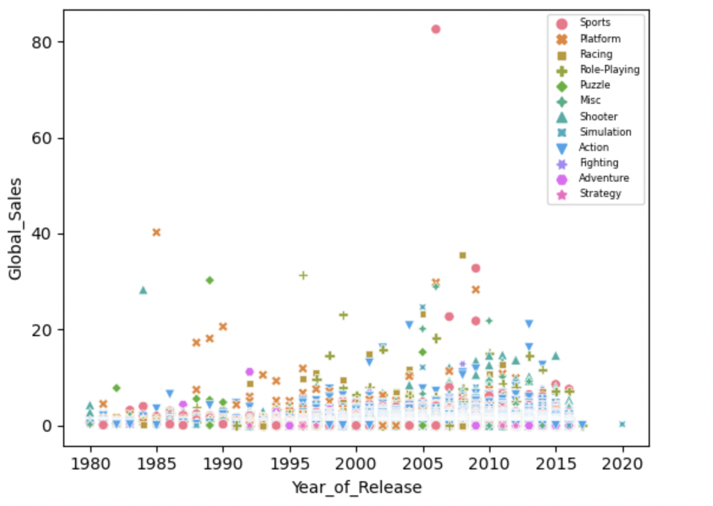
EDA (Cont.)
Relationship between the Year_of_Release, and Global_Sales
Little to no correlation between the year a game is released and the sales number for games globally
While games have gotten more popular over the years, the higher quantity of games does not automatically translate to the quality of them which the sales would be a clear indicator of
Wii Sports extreme outlier in 2006 (Bundle)

Slide 10
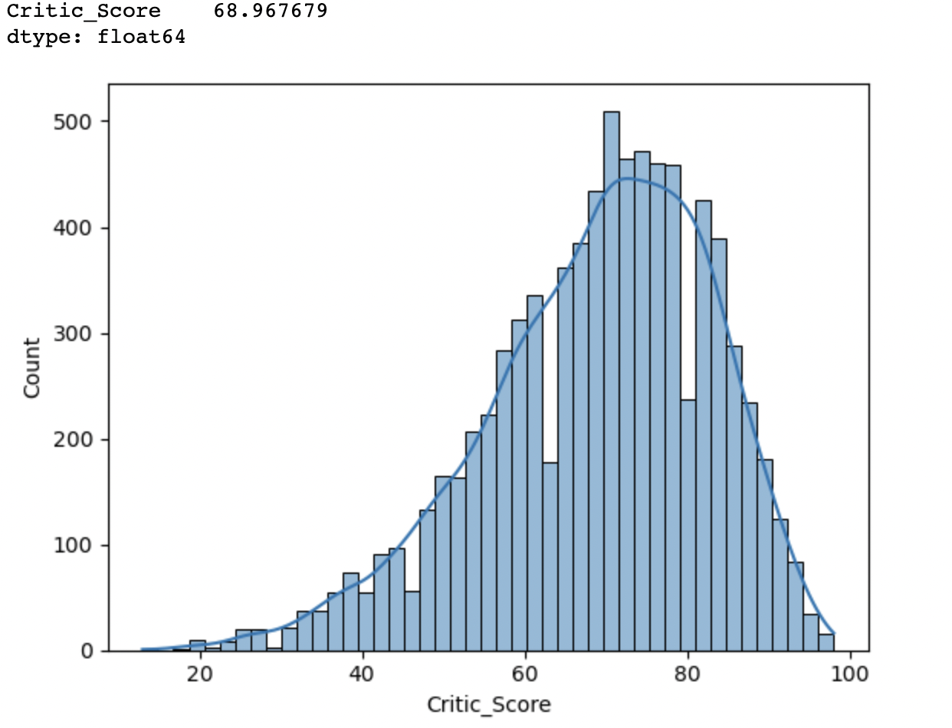
EDA (Cont.)
Distribution of Critic_Score
This is a good indicator that games generally rate above average (50) on a 0 to 100 rating scale. Histogram supports mean
There are relatively few data points with low values (bad games) and a relatively large number of data points with high values (average and exceptional games)
Game developers have done good as a collective throughout the years!

Slide 11

04
Data Questions
Answering Intriguing Questions About Video Games

Slide 12
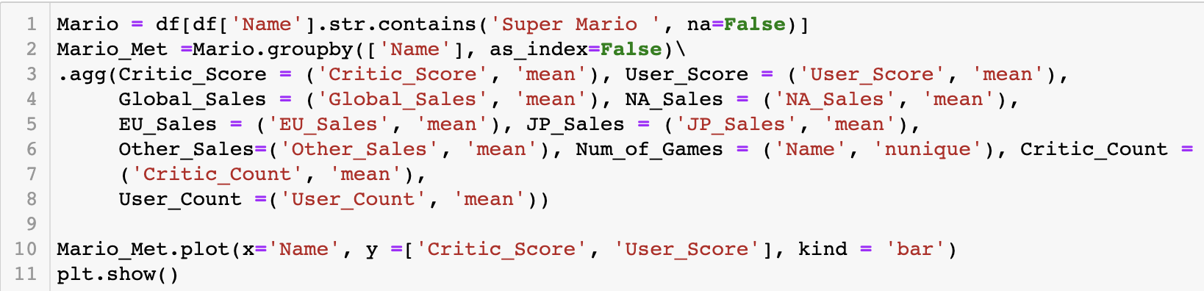
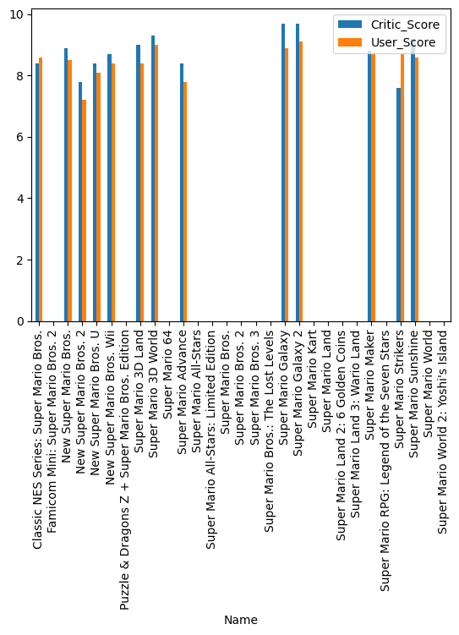
What Games are Best per Series?
We want to look at popular games that were apart of a series, and determine which game was the best in terms of sales and scores in that series.
First is the Super Mario Series:
The best game in the Mario Series according to critic score are both Super Mario Galaxy and Super Mario Galaxy 2 (9.7)
The best game by user score is Super Mario Galaxy 2 (9.1)

Slide 13
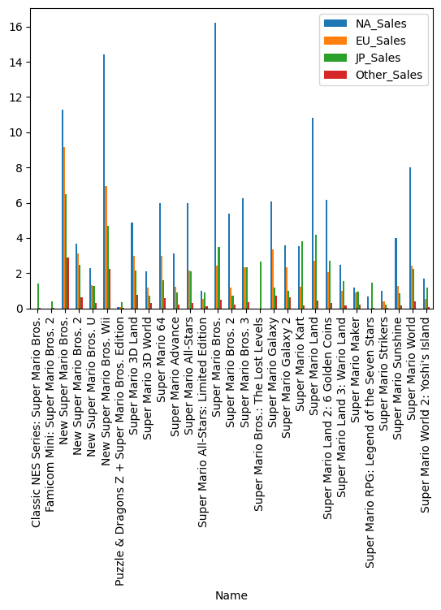
What Games are Best per Series? (cont.)
This chart is comparing the quantity of sales per game in the Super Mario Series, while also accounting for area of sale:
Super Mario Bros. was the highest selling Mario game in North America, Europe, and Japan
Mario games tend to sell the best in North America overall

Slide 14
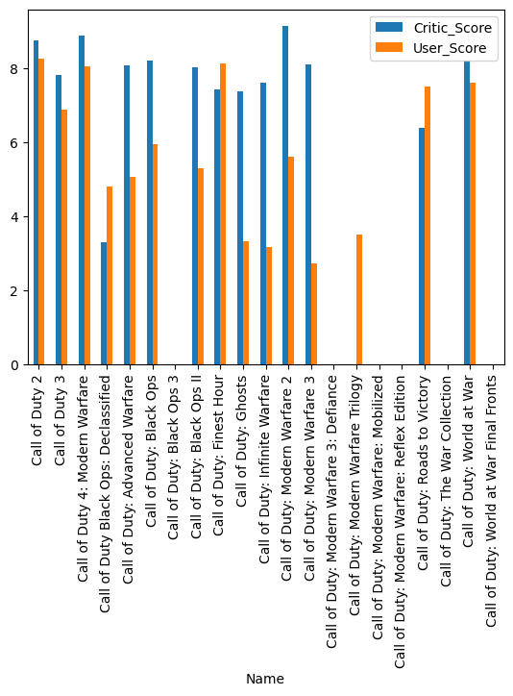
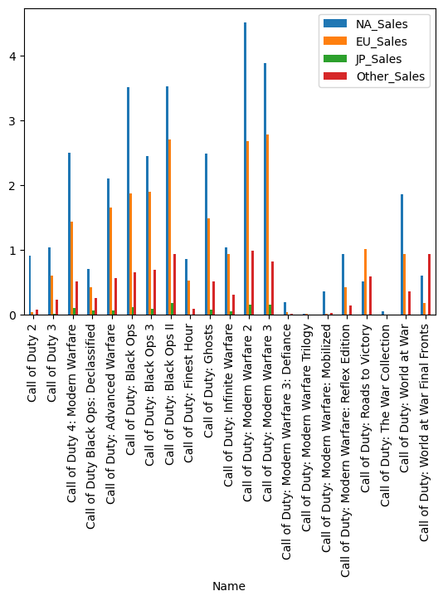
What Games are Best per Series? (cont.)
Next is the Call of Duty Series
These charts were created with similar code to the Mario examples
The best game in the Call of Duty Series according to Critic_Score is Call of Duty: Modern Warfare 2 (9.1)
Top best game according to User_Score is Call of Duty 2 (8.2)
The best selling games by area are:
North America & Europe: Call of Duty: Modern Warfare 3
Japan: Call of Duty: Black Ops 3

Slide 15
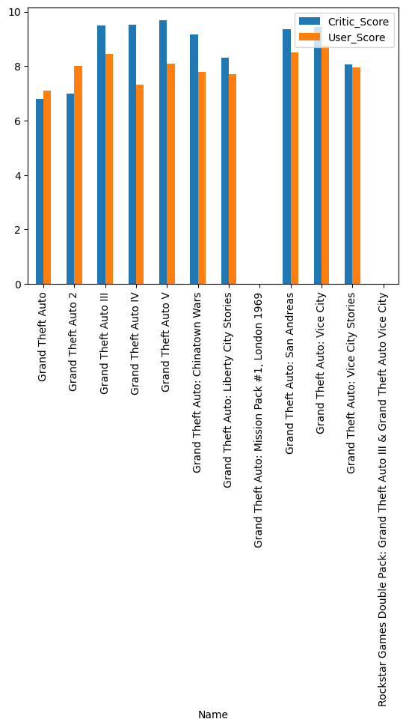
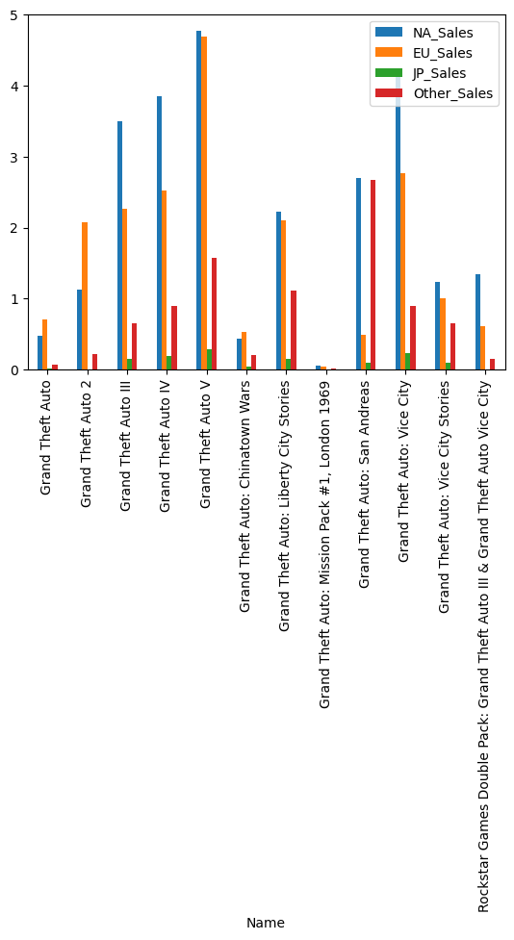
What Games are Best per Series? (cont.)
Finally, let's look at the Grand Theft Auto Series
The best game in the GTA Series according to Critic_Score is Grand Theft Auto V (9.7):
Top best game according to User_Score is Grand Theft Auto: Vice City (8.7)
The best selling games by area are:
North America & Europe: Grand Theft Auto V
Japan: Grand Theft Auto: San Andreas

Slide 16
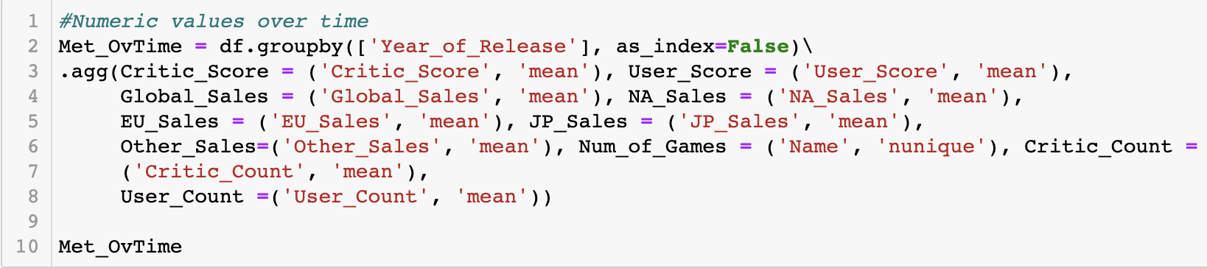
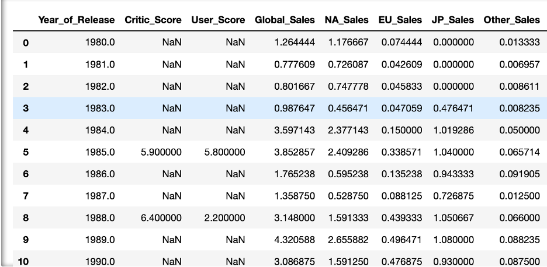
More Data Questions: Redefining Dataset
Our next analysis involved grouping the data in different ways to get answers to our questions. Most of our questions involve the trends of specific metrics over a period of time, therefore we created a new data frame that was grouped by a game’s year of release and calculated averages for all numeric columns. Below is a snapshot of this new data frame:

Slide 17
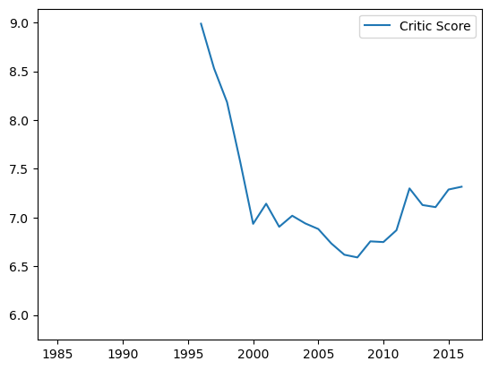
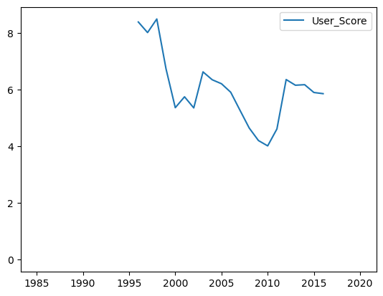
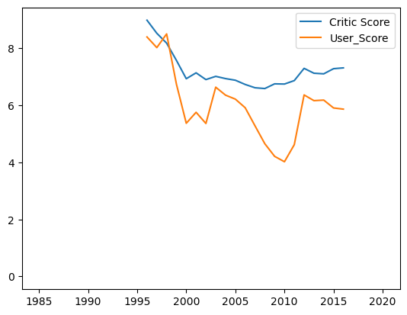
Have Video Games Become Better Over Time?
Critic_Score and User_Score were used as a measure of satisfaction
The Critic scores were given by MetaCritic staff, while user scores were given by Metacritic subscribers
These MetaCritic subscribers are mostly common gamers. We visualized this data over time and obtained the results below:

Slide 18
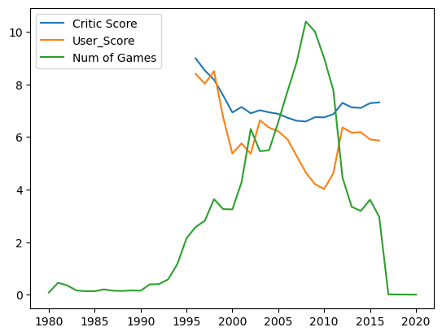
Are There Other Factors That Can Explain These Results?
Taking a step further and try to determine if there were other data points that could have influence on scores
The number of games released in a given year appears to be inversely related with critic and user scores. The results are visualized below:
Note: The values in Num of Games were divided by 100 for visualization purposes.

Slide 19
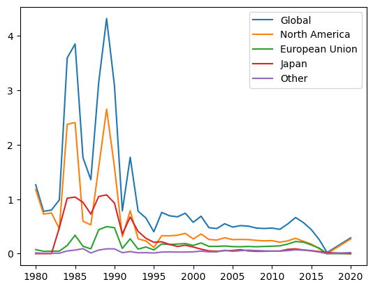
What Are the Video Game Sales Per Area and Globally?
North America, Europe, and Japan all have similar trends in sales
There are huge peaks around years 1984-1985, and 1989 and there are dips in years 1986-1987
After 1995 sales numbers flatten out and are more consistent

Slide 20
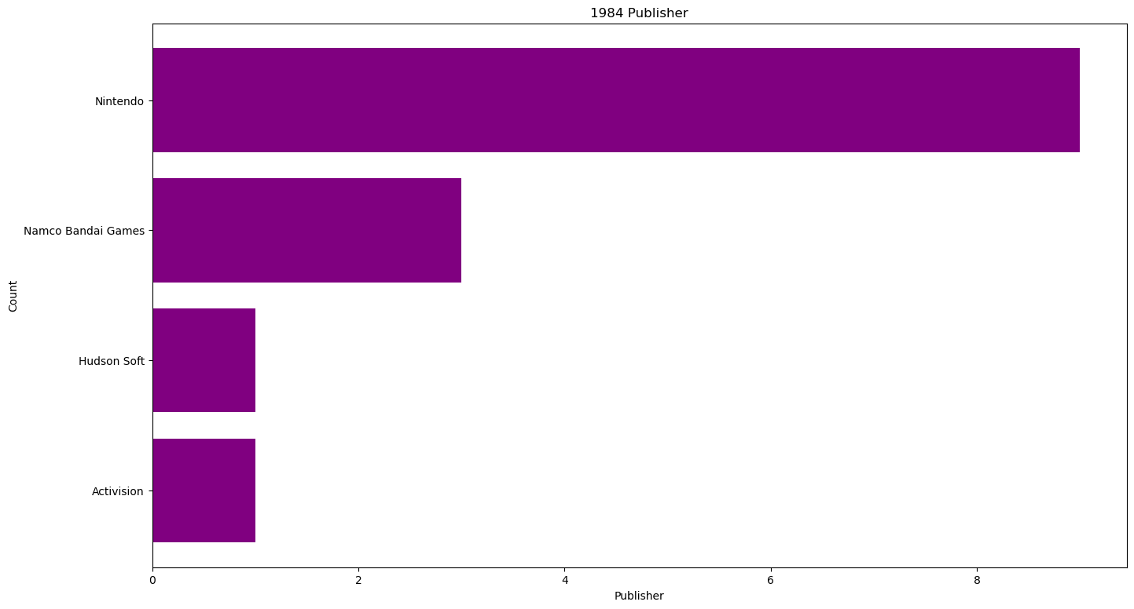
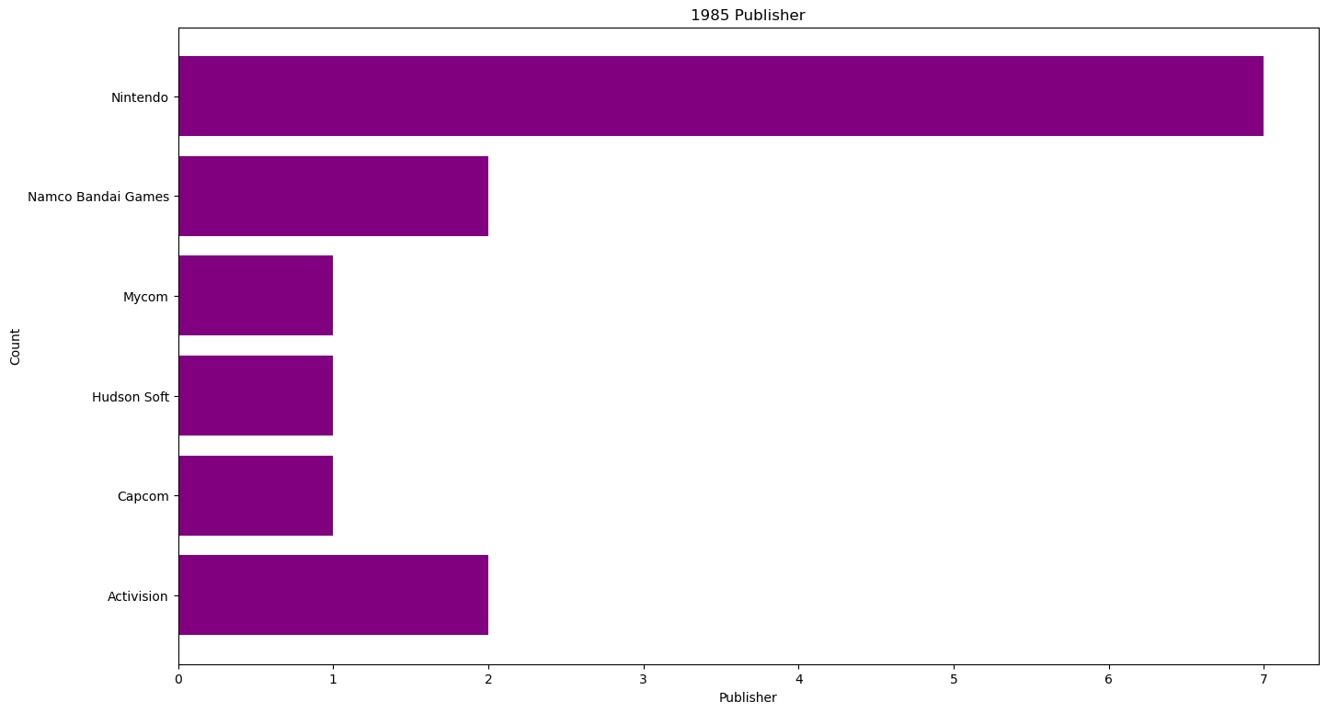
What could have contributed to the similar pattern we see between years 1984 and 1990?
To answer this, we analyze some of the categorical variables over the years in search of a similar pattern. The categorical variables include genre, developer, platform, publisher, and rating. We grouped by the year and calculated the sum of each unique category of a specific variable within that year.
After calculating and visualizing the distribution of these categorical variables for each year from 1984-1990 we found that the publisher variable has a similar pattern with sales. In the years 1984 and 1985, Nintendo outproduced other publishers by an average of 7.33 and 5.6 games. These are the years we saw peak numbers in sales:

Slide 21
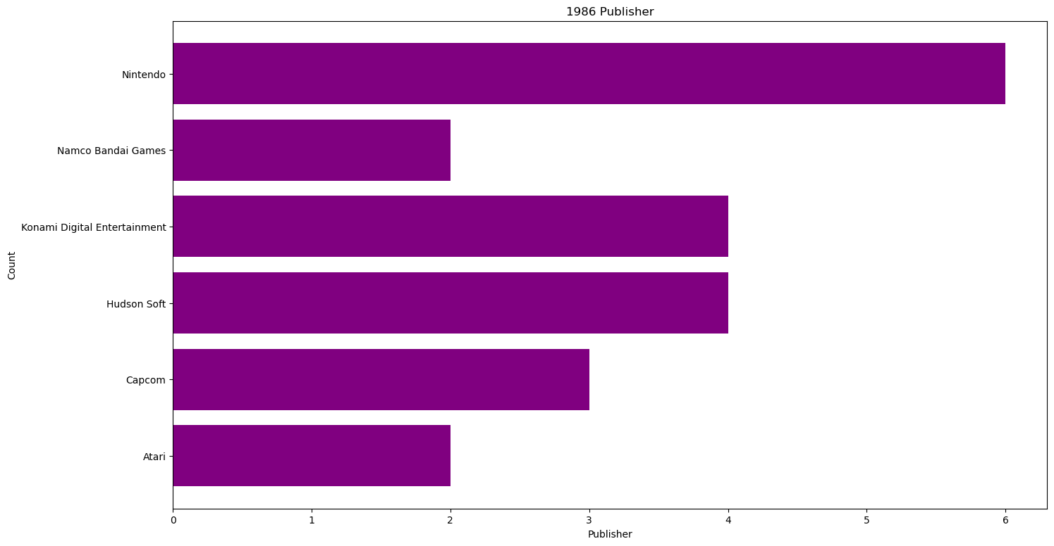
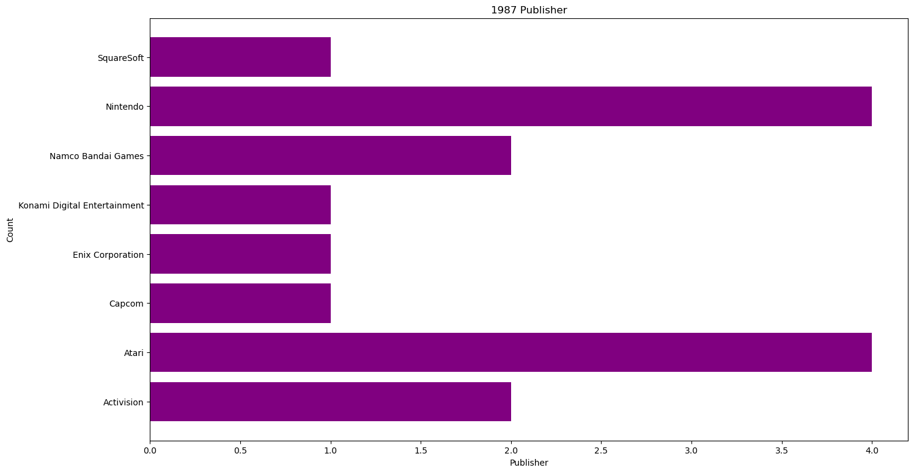
What could have contributed to the similar pattern we see between years 1984 and 1990?
In 1986 and 1987, Nintendo outproduced other publishers by an average of 2.6 and 2.3 games
These are years we saw major dips in sale numbers:

Slide 22
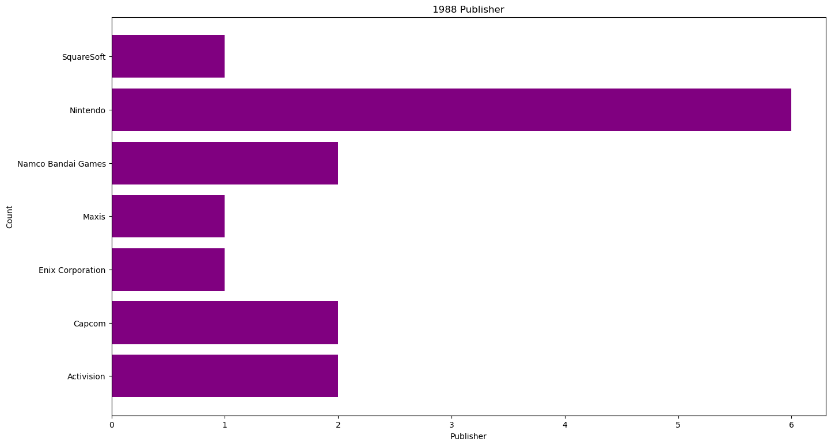
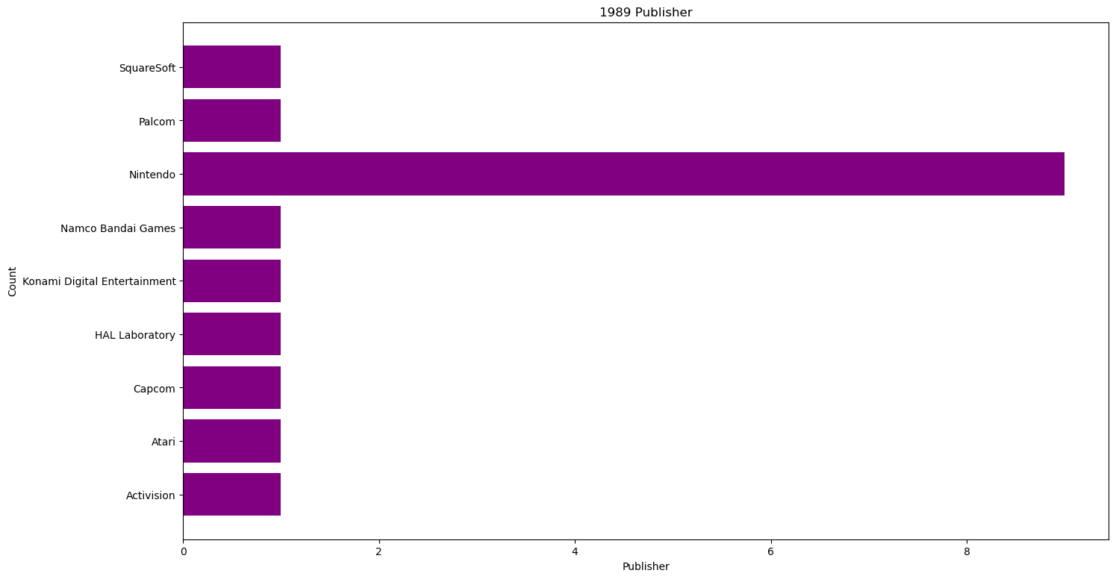
What could have contributed to the similar pattern we see between years 1984 and 1990?
In the year 1988 Nintendo outproduced other publishers by 4.5 games. This year saw an increase in sales.
In 1989 sales reached their highest numbers. This year, Nintendo outproduced other publishers by its largest margin, 8 games.
Here are charts for both years:

Slide 23

05
Analysis & Conclusion
Final Thoughts and Findings

Slide 24
Analysis and Conclusion
Sales numbers tend to mirror Nintendo's level of production dominance over other publishers
Video game scores generally decreased over time, likely due to the quantity of them
Users and critics were generally in agreement on their judgement of games
When there are less games available, people tend to enjoy them more. As the number of games increase, the satisfaction/score of games decrease
Games sell best in North America in comparison to Europe and Japan

Slide 25
THANK YOU!

